Slide 1
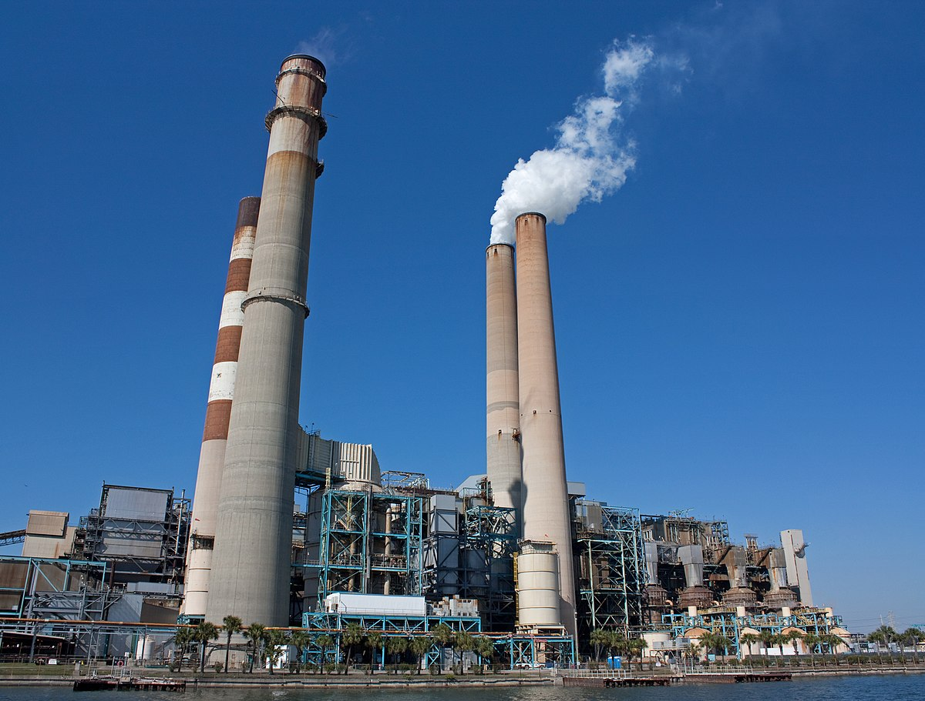
Powerhouse Water Level Instrument Self-Survey Template
Contact Information:
Name: |  | Email:
Phone: |  | Location:

Slide 2
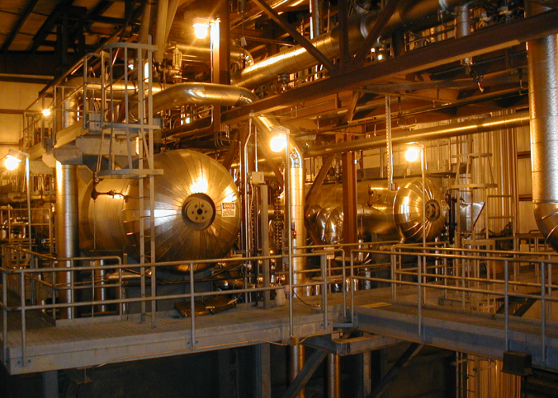
Boiler Drum

Slide 3
Boiler Self-Survey
Drum Identification:
Design Pressure: |  |  | Design Temperature:
Operating Pressure: |  |  | Operating Temperature:
Gage Glass
Gage Glass Visibility:
Valve Connection Centers:
Connection Size:
Connection Type:
Remote Level Indicator(s)
Type: | Probe type □ DP □ GWR □ Magnetic Gage (w/transmitter) □
Connection Size:
Connection Type:
Notes:

Slide 4
Your Boiler Drum Level Instrument Photos & Notes Copy slide as needed

Slide 5
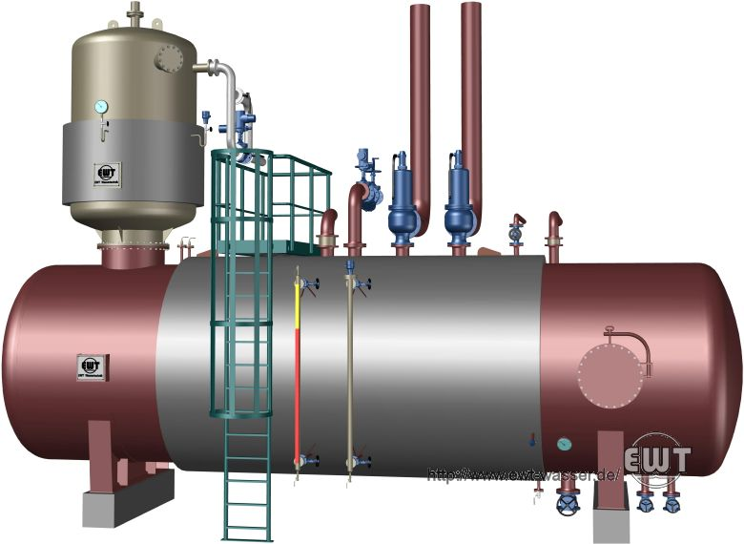
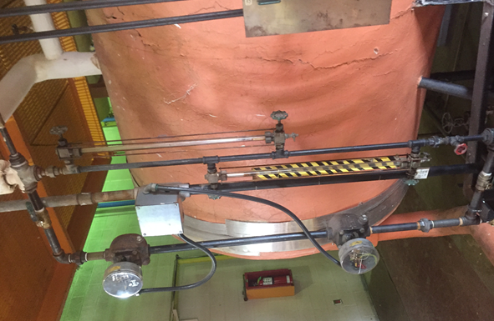
Deaerator
Note: Gage Glass or Magnetic are typical

Slide 6
Deaerator Self-Survey
Deaerator Identification:
Design Pressure: |  |  | Design Temperature:
Operating Pressure: |  |  | Operating Temperature:
Gage Glass
Gage Glass Visibility:
Valve Connection Centers:
Connection Size:
Connection Type:
Switches or Magnetic Gage Information
Type:
Connection Size:
Connection Type:
Notes:

Slide 7
Your Deaerator Level Instrument Photos & Notes Copy slide as needed

Slide 8
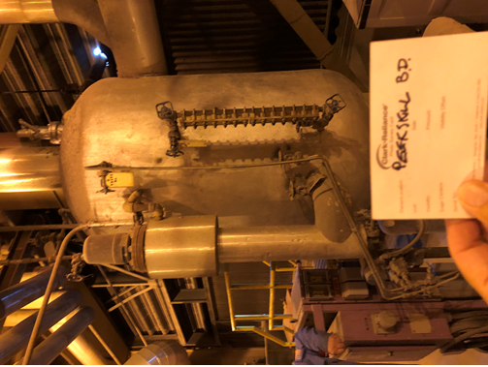
Condensate & Blowdown Tank
Note: Gage Glass or Magnetic are typical

Slide 9
Tank Self-Survey
Tank Identification:
Design Pressure: |  |  | Design Temperature:
Operating Pressure: |  |  | Operating Temperature:
Gage Glass
Gage Glass Visibility:
Valve Connection Centers:
Connection Size:
Connection Type:
Switches or Magnetic Gage Information
Type:
Connection Size:
Connection Type:
Notes:

Slide 10
Your Condensate and Blowdown Tank Level Instrument Photos & Notes Copy slide as needed

Slide 11
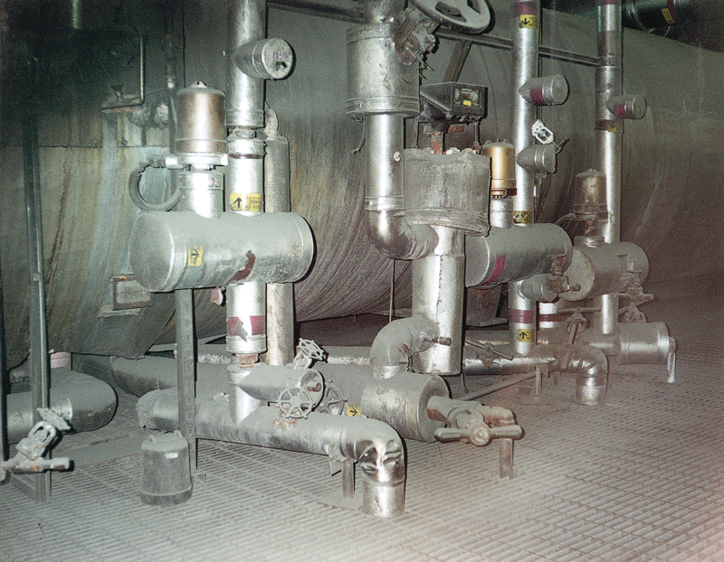
Feedwater Heater

Slide 12
Feedwater Heater Self-Survey
Feedwater Heater Identification:
Design Pressure: |  |  | Design Temperature:
Operating Pressure: |  |  | Operating Temperature:
Gage Glass
Gage Glass Visibility:
Valve Connection Centers:
Connection Size:
Connection Type:
Switches or Magnetic Gage Information
Type:
Connection Size:
Connection Type:
Notes:

Slide 13
Your Feedwater Heater Instrument Photos & Notes Copy slide as needed

